Slide 1


SMART INDIA HACKATHON 2025
TITLE PAGE
Problem Statement ID – 25057
Problem Statement Title- Automated Compliance Checker for Legal Metrology Declarations on E-Commerce Platforms.
Theme - Miscellaneous
PS Category- Hardware
Team ID-
Team Name - Astricks

Slide 2

Regulense : Package Compliance Checker
Proposed Solution
Edge integration: Raspberry Pi demonstrates real-world capture, ensuring scalability in warehouses or retail.
Scalability: Laptop/Server-based processing allows handling large datasets; models can later be deployed directly to Raspberry Pi 5 for true edge compliance.
User-friendly: A minimal modern dashboard makes results easy to interpret for inspectors with no technical background.
Edge-Integrated Compliance Capture
Unlike existing OCR apps that work only on mobile/PC, our solution integrates a Raspberry Pi (or mobile as fallback) as a dedicated edge capture device.
Hybrid Architecture (Edge + Central Processing)
Lightweight capture on Pi + heavy OCR/validation on laptop ensures reliability even on low-powered devices.
Automated Compliance Scoring & Reports
The system doesn’t just say what text was found - it flags missing/invalid fields and generates a compliance score with explanations.
Solution Approach
Edge Capture - Raspberry Pi (or mobile fallback) captures product label images at source.
Central Processing - Laptop/Server receives images, handles preprocessing, OCR, and compliance validation.
Preprocessing - Enhance images (grayscale, thresholding, denoise).
PaddleOCR Lite - Extract multi-language text efficiently.
Problem Understanding:
Manual inspection of product labels for Legal Metrology compliance is time-consuming and error-prone.
Innovation & Uniqueness

Slide 3
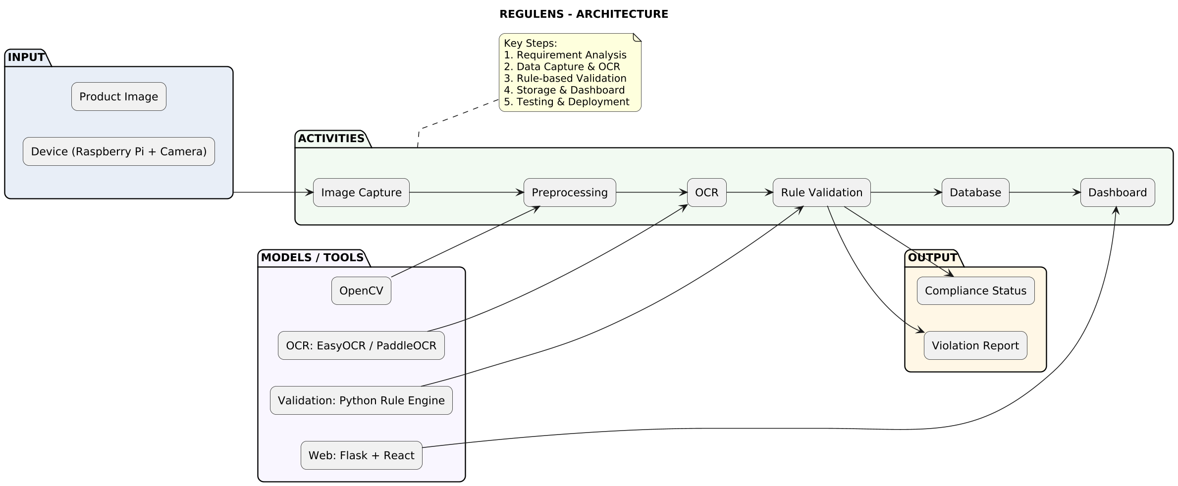






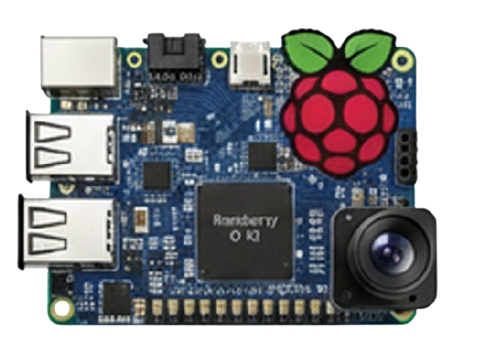

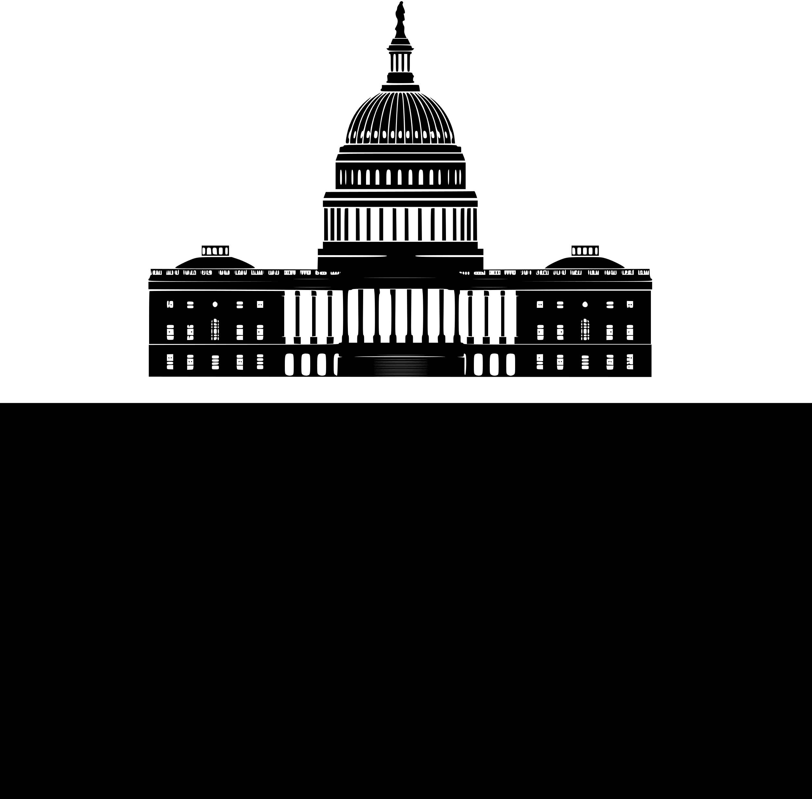
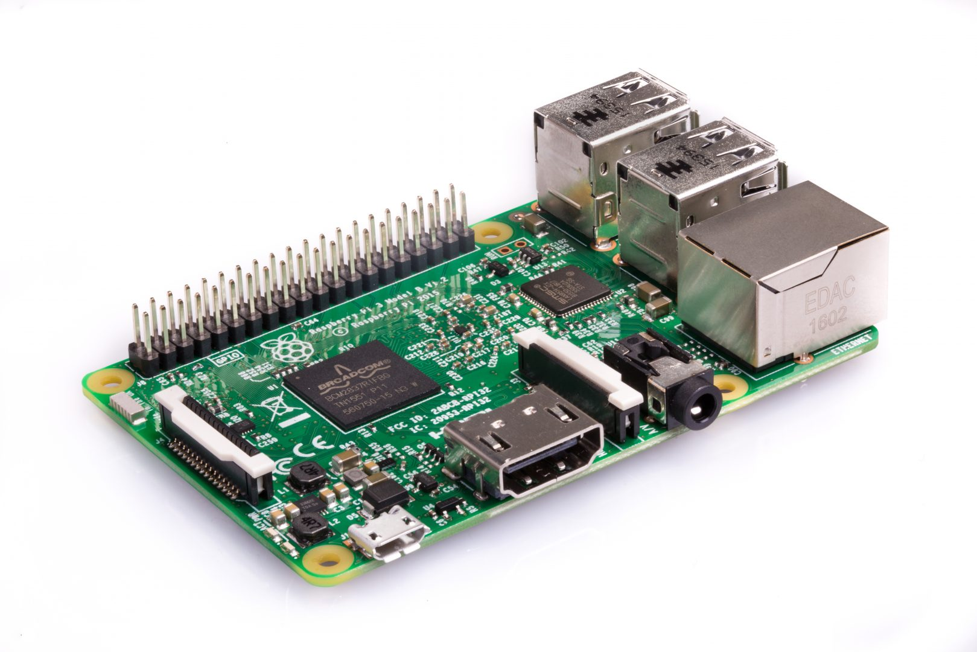
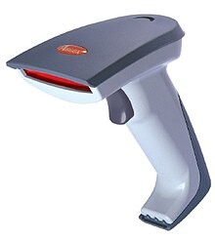
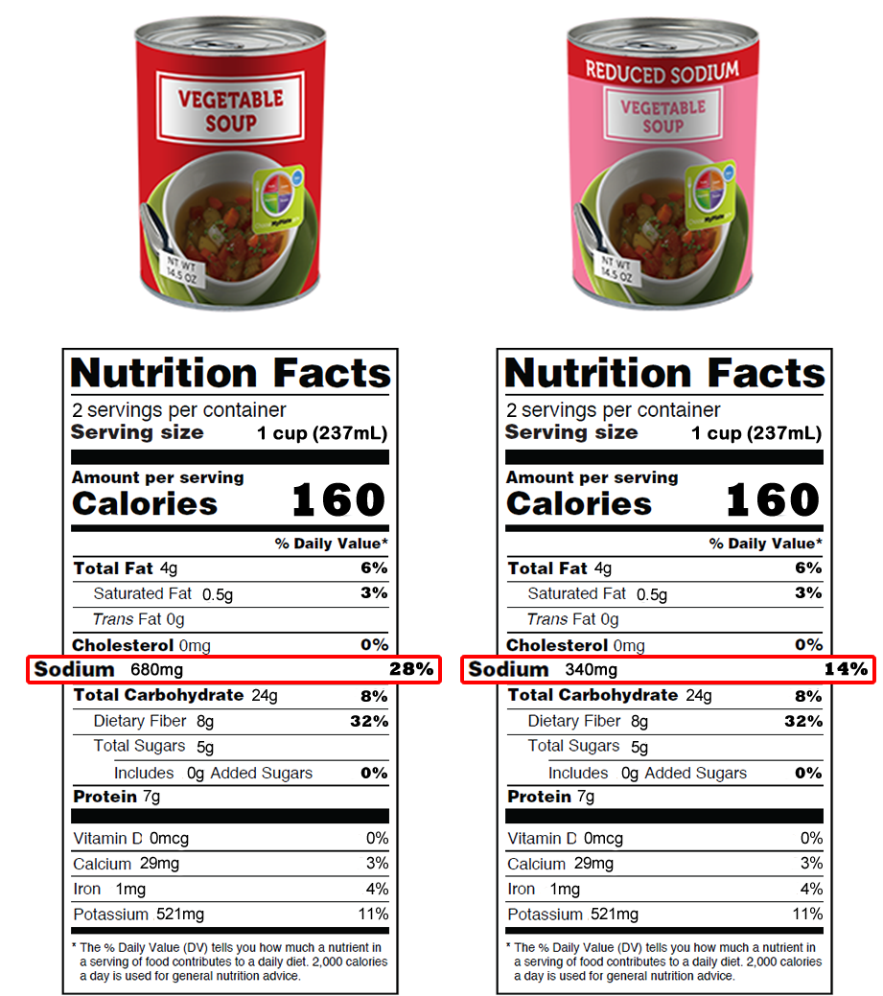
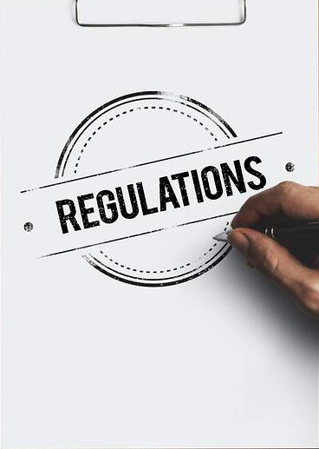

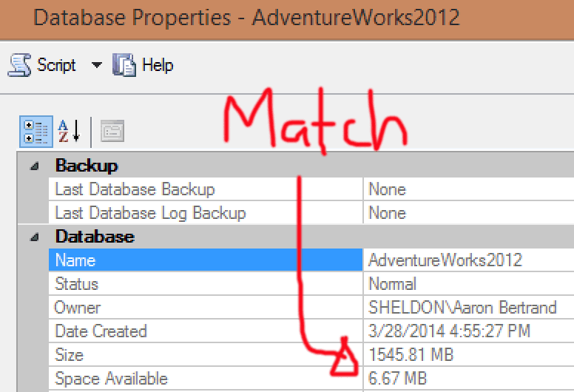




TECHNICAL APPROACH
Methodology for processing the workflow :
Image Capture at Source
A Raspberry Pi (or mobile device) captures the product label image using its camera.
Data Transfer to Processing Hub
The captured image is transmitted over Wi-Fi using HTTP POST to a Flask API running on the laptop.
Image Preprocessing
On the laptop, OpenCV enhances the image for OCR: resizing, grayscale conversion, thresholding, and noise removal.
OCR Text Extraction
PaddleOCR Lite, it extracts text lines in structured form (bounding boxes + recognized text).
Rule Engine Compliance Validation
As per Legal Metrology Rules, 2011: Each field is validated with regex patterns and logic checks (e.g., MRP must include ₹ or Rs., Net Quantity must have a standard unit).
Database Storage
Results (raw OCR + compliance status + violations) are stored in a SQLite database.
Dashboard Visualization
A web dashboard (Flask + React) presents results to regulators/inspectors. stores compliance score, violation summary, history of scans, and exportable reports.
Decision & Reporting
System flags each product as Compliant or
Non-Compliant(e.g., missing MRP, invalid date)
1
2
3
4
Dashboard Reporting
5
6
Image Capture
Text Extraction
Rule Engine Validation
Data Storage
Testing & Deployment
Product photos from
e-commerce & Field Scanner
missing?
Extracts text from images; multi-language support
Checks text against Legal Metrology Rules (MRP, Net Qty, Origin, etc.)
Secure database; stores results, regulations, violations, and evidence
Visual dashboard for regulator;
expertable violation reports
Validation & testing; scalability, feasibility Govt. integration
Approved

Slide 4
FEASIBILITY AND VIABILITY
Potential Challenges & Risk
Feasibility Analysis
Overcoming Challenges
OCR Accuracy: Tilted packaging, multilingual labels, and poor image quality can all affect text recognition.
Hardware Restrictions: The Raspberry Pi might not be able to handle demanding AI/OCR processing jobs.
Problems with connectivity: Reliable internet access is necessary for cloud-based OCR.
Regulatory Changes: Constant system adaptation is necessary due to frequent updates in Legal Metrology regulations.
Adoption Barriers: Stricter compliance checks may be resisted by some sellers, and inspectors require training.
Technical Viability: Tesseract and EasyOCR are ready-to-use OCR/AI models. The Raspberry Pi with camera is reasonably priced.
Economic Feasibility: The prototype is scalable and significantly less expensive than manual inspections thanks to cloud integration.
Operational Ability: Easy monitoring and fast reporting are made possible by a centralised dashboard that requires little training.
Regulatory and Legal Viability: Complies with the 2011 Legal Metrology Rules and aids in government initiatives to comply with digital standards.
OCR Efficiency Problems: To improve accuracy, train models on Indian retail data, employ multilingual OCR, and apply image preprocessing. Hardware constraints: Use Raspberry Pi models that are optimised for heavy tasks and are lightweight, with cloud fallback. Dependency on accessibility: To manage erratic or low internet, offer offline-first OCR with local caching. Regulatory Changes: Make use of a rule engine that is modular and adaptable so that new Legal Metrology guidelines can be added quickly.
Revenue Sources
E-commerce Platform Integration : Paid API/plugin for Amazon, Flipkart, etc., to auto-check seller compliance.
Data Insights & Analytics : Paid reports on compliance trends, category-wise violations, and seller performance.
Hardware Sales : Low-cost Raspberry Pi + camera kits sold to inspection agencies or enterprises.

Slide 5
IMPACT AND BENEFITS
Potential impact
Benefits of the solution
Protection of consumers: Guarantees that purchasers always receive correct information, such as MRP, net quantity, and origin. Trust and Transparency: Promotes trust in both online and offline purchasing. Fair Trade Practices: Lowers the possibility of deceptive packaging leading to exploitation.
Reduced Penalties for Businesses: Assists sellers and manufacturers in spotting mistakes early on, preventing penalties. Encouragement of E-Commerce Reliability: By ensuring compliant listings, platforms can draw in more clients. Efficiency for Regulators: Reduces labour costs and expedites enforcement actions.
Decreased Paperwork: Digital compliance reports eliminate the need for manual records and paper forms. Reduced Waste: Reprinting and mass product recalls are avoided by early identification of labelling errors.
Platforms for E-Commerce: Automated verification prior to listings going live is known as Seller Compliance Assurance.
Producers and Vendors:
Early Error Detection: Finds missing or inaccurate statements before goods are put on the market.
Decreased Penalties:
Reduces the likelihood of fines and legal risks brought on by non-compliance
. Transparent Information: Guarantees that each product's MRP, quantity, and origin information are correct.
Fair Trade Protection:
Prevents overcharging or misleading packaging. In both online and physical marketplaces, empowered decision-making fosters trust.
Social Advantages
Financial Gains
Advantages
for the Environment

Slide 6
RESEARCH AND REFERENCES
The study is relevant to our project as it addresses similar OCR challenges.
Demonstrates the value of lightweight OCR models for accuracy.
Shows feasibility of running OCR on edge devices like Raspberry Pi.
DISGO: Automatic End-to-End Evaluation for Scene Text OCR.
By Mei-Yuh Hwang, Yangyang Shi, Ankit Ramchandani, Guan Pang, Praveen Krishnan, Lucas Kabela, Frank Seide, Samyak Datta, Jun Liu DOI: 10.48550/arXiv.2308.13173
link : https://drive.google.com/file/d/1wEFp7mydd5Igp0nMkjoayqNrG63ZHNBb/view?usp=drive_link
NLP improves legal text translation, automates terminology, and ensures consistency.
Human oversight is still required for accuracy and reliability.
Highlights the need for domain-specific NLP in Legal Metrology compliance.
The Role of Natural Language Processing (NLP) in Translating Legal Documents with High Accuracy.
By Mavluda Ahmedshaeva, Nodirakhon Pulatova, Sherzod Khayitov, Dilafruz Sufiyeva4 and Mohinur Nizomova at IJSR DOI: 10.51983/ijiss-2025.IJISS.15.2.12
link : https://drive.google.com/file/d/1GPlCDGIr6VxEA8y-TfS8qyQbpejsiigM/view?usp=drive_link
Proposes a pipeline combining image restoration and post-OCR correction.
Achieves 60%+ reduction in OCR errors on degraded text.
Improves OCR for tilted, blurry, and multilingual labels.
Directly supports accurate Legal Metrology compliance checks.
PreP-OCR: A Complete Pipeline for Document Image Restoration and Enhanced OCR Accuracy.
By Shuhao Guan, Moule Lin, Cheng Xu, Xinyi Liu, Jinman Zhao, Jiexin Fan, Qi Xu, and Derek Greene. DOI: 10.48550/arXiv.2505.20429
link : https://drive.google.com/file/d/1xZBV24YyIomgg2tUYEdKR6PDo58ja7EX/view?usp=drive_link
Comparing Traditional OCR with Generative AI-Assisted OCR: Advancements and Applications.
By Dhavalkumar Patel, Volume 14 Issue 6, June 2025, International Journal of Science and Research (IJSR) DOI: 10.21275/SR25603211507
Traditional OCR: Struggles with tilted and multilingual text.
Lightweight AI + Cloud Support: Enables efficient compliance checks.
Relevance: Directly supports retail packaging compliance verification.
link : https://drive.google.com/file/d/1wEFp7mydd5Igp0nMkjoayqNrG63ZHNBb/view?usp=drive_link

